Slide 1


Advancing reproducibility through team science, data sharing, and transparency: the ENIGMA initiative _____________________________
Frank G. Hillary, Ph.D.
Professor of Psychology and Neurology
Social Life and Engineering Sciences Imaging Center
Pennsylvania State University
fhillary@psu.edu

Slide 2
Can data sharing help meet the challenges we face in reproducible research?

Slide 3
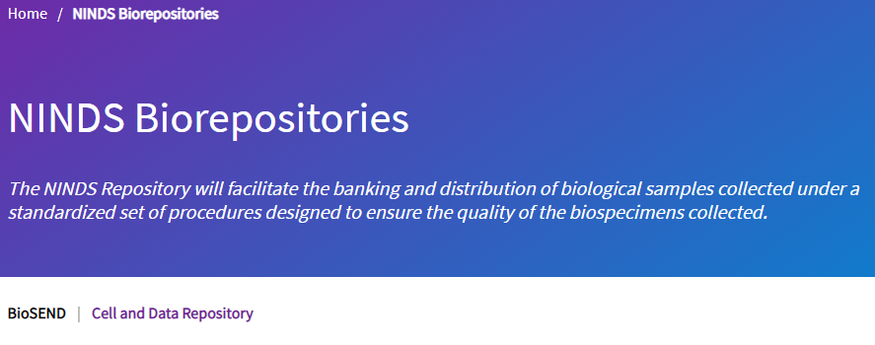
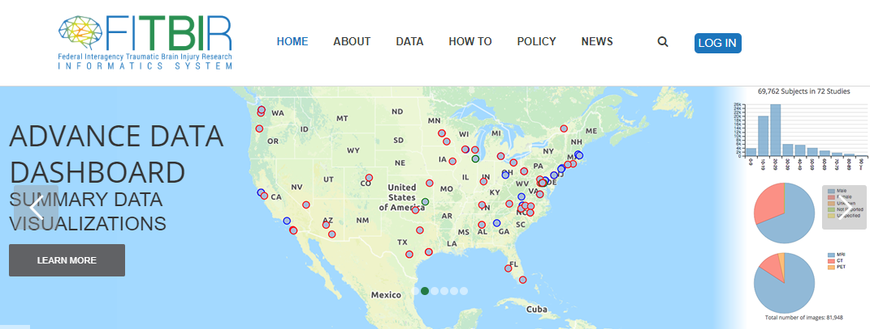

Sharing data is becoming standard…

Slide 4


Sharing advances science…

Slide 5

Sharing works best when its OPEN…

Slide 6
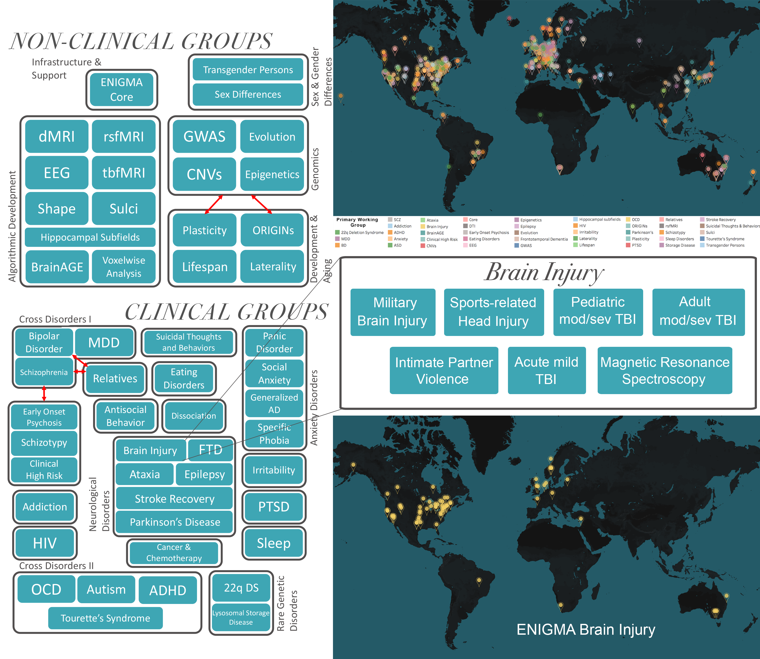

What is ENIGMA?
2020: Worldwide Consortium–2000+ collaborators;
51 workgroups/31 disorders, 45 countries
Paul Thompson, PhD

Slide 7
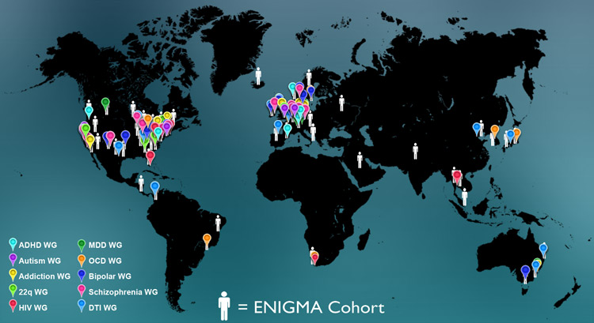
ENIGMA Participants
enigma@ini.usc.edu

Slide 8
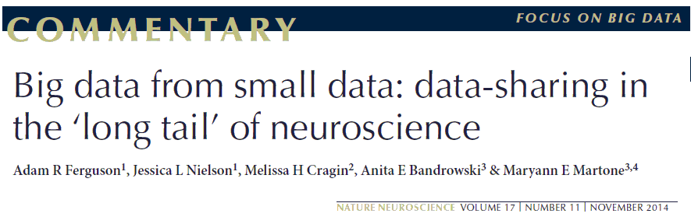
ENIGMA leverages ALL data…

Slide 9
ENIGMA
What it is:
Global collaboration with specific groups focused on various psychiatric and neurological disorders
Framework for harmonized data processing and analysis
Processing help (when needed)
Complementary approach to individual studies
What it is NOT
A data repository
An alternative to well-characterized cohort studies

Slide 10
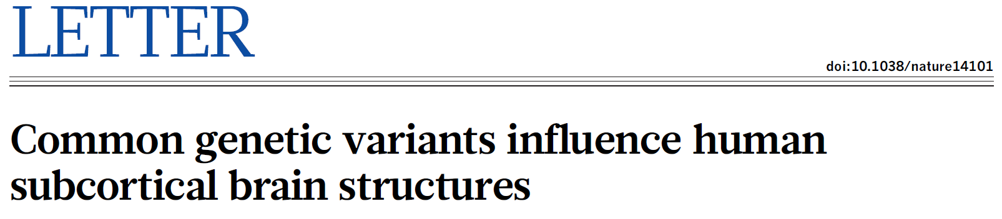
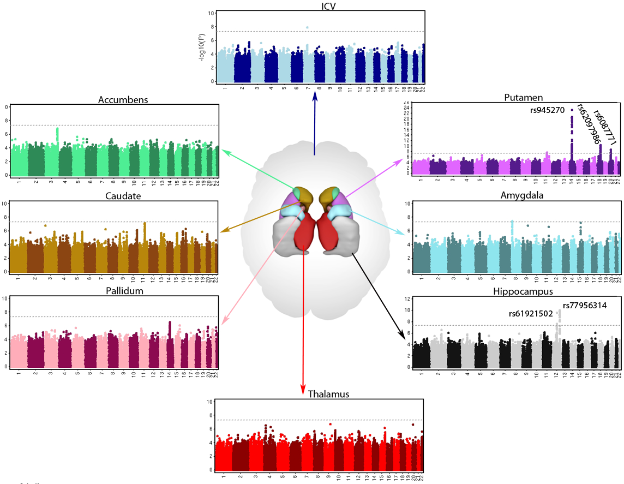
Genetics of subcortical volume in 33,000 People
Notes:
Manhattan plots – where along genome is there variation that’s associated with volume
Nice to know how genetics influences brain structure, but what does this mean functionally?

Slide 11
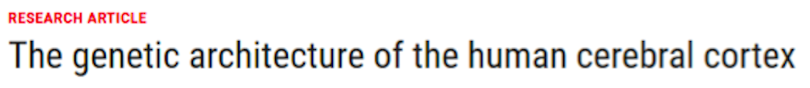
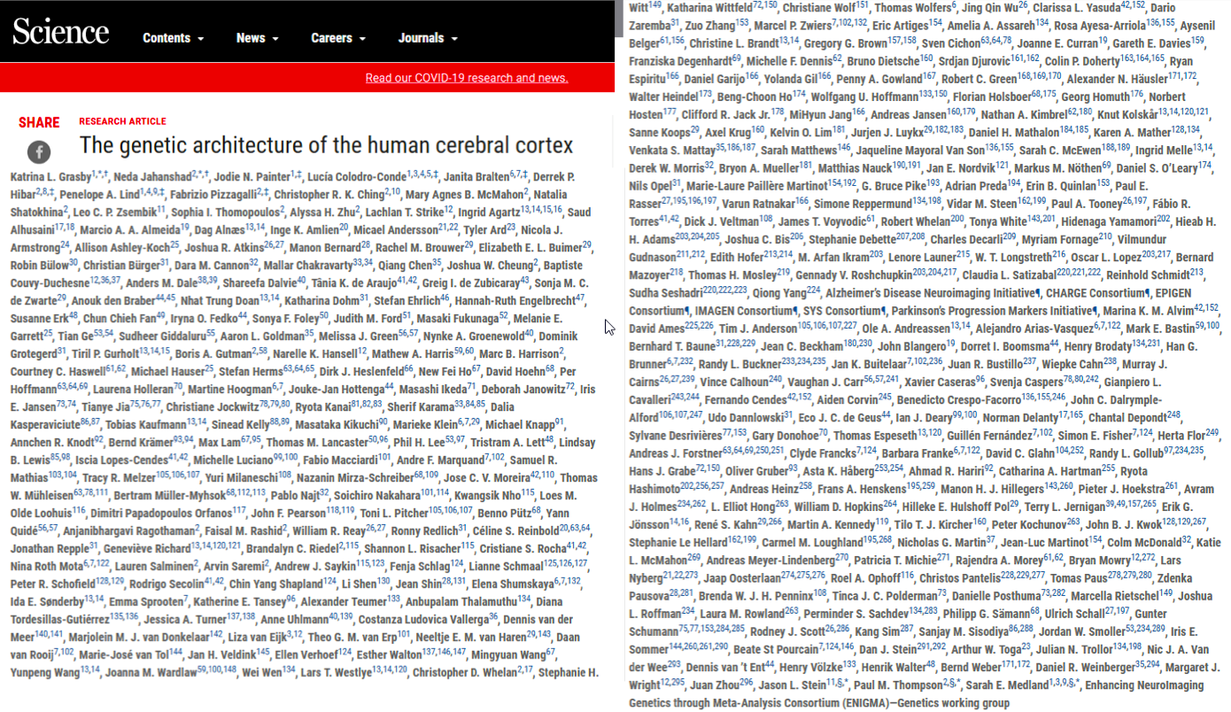
51,665 individuals
Science, March 20 2020
Notes:
And here are our VERY preliminary results. For total surface area of the human cortex (which is phenotypically highly correlated to ICV), we find an association with the chr17 inversion. We find no genome-wide significant loci associated with cortical thickness at this preliminary stage. As said though this is very preliminary and our N will double as soon as issues with the other cohorts are taken care of.
Currently 25 sites uploaded: N~13,243
13 cohorts pass QC: N~7,200
Other cohorts are either being fixed or sites re-contacted
In total ~70 phenotypes including total surface area and total thickness

Slide 12

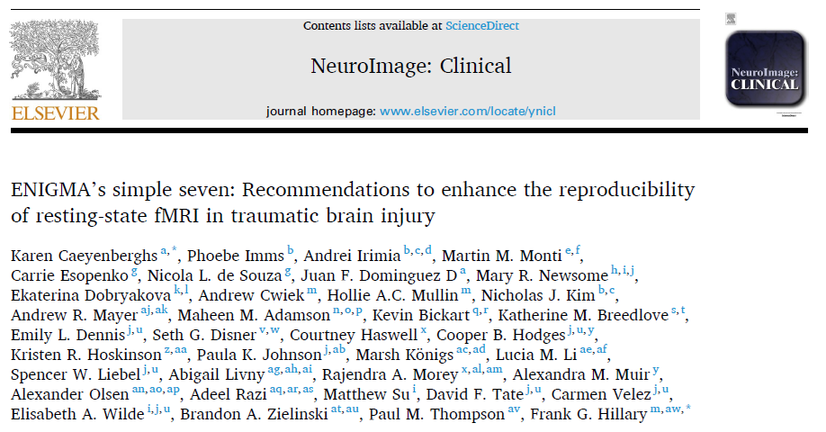

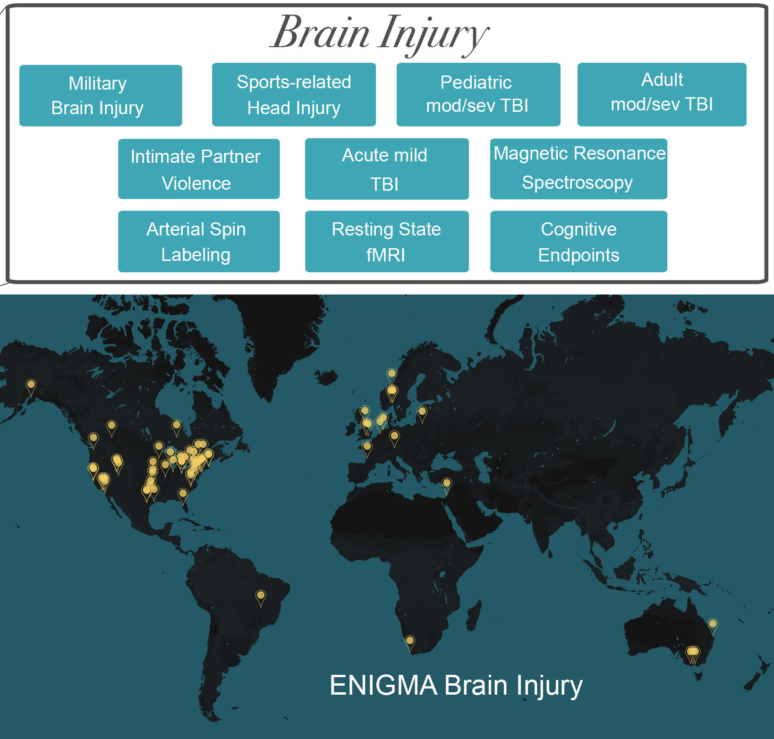
ENIGMA Brain Injury initiated fall 2016
Elisabeth Wilde,PhD David Tate, PhD Emily Dennis, PhD
2020: Worldwide Consortium
178 investigators
82 institutions
13 countries

Slide 13
Can we simplify data sharing to accelerate science?

Slide 14
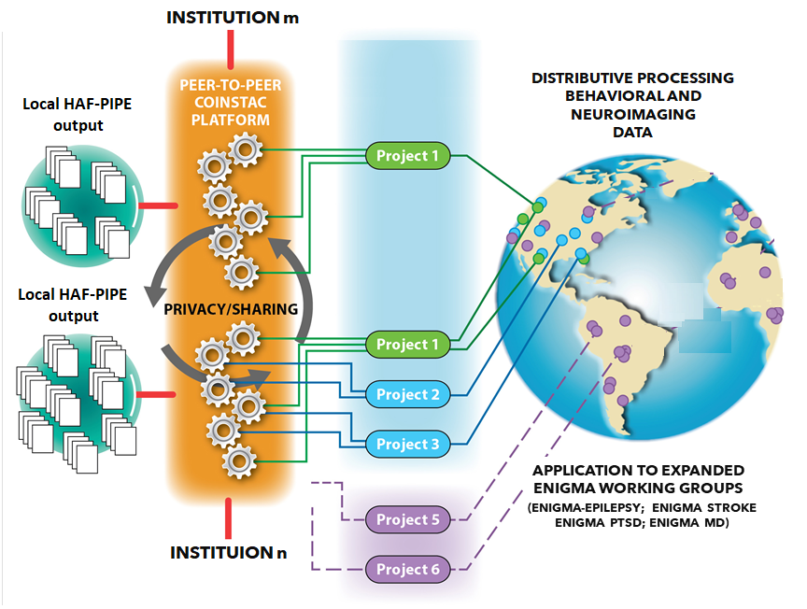

NINDS: R61 NS120249

Slide 15
Harmonization and Aggregation for Functional and structural imaging data PIPEline:
NINDS: R61 NS120249

Slide 16
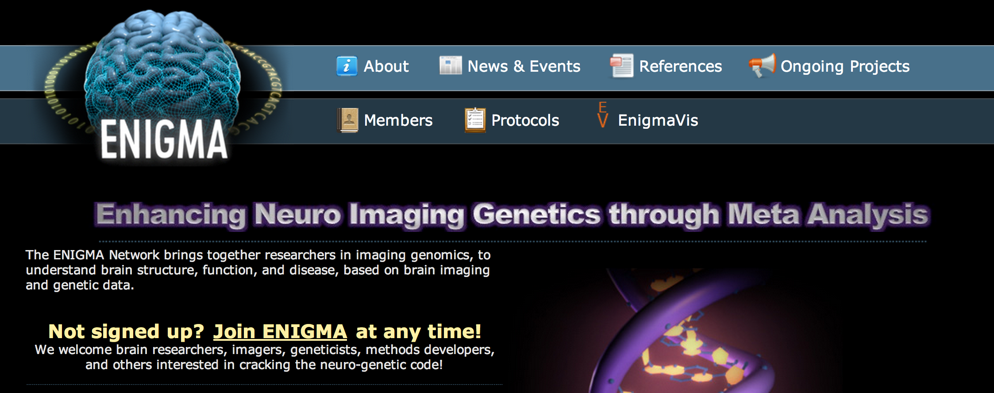
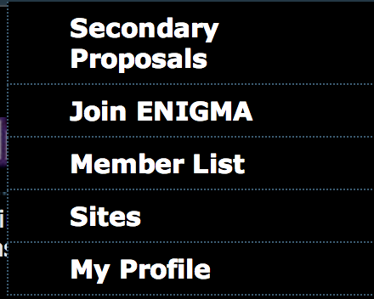
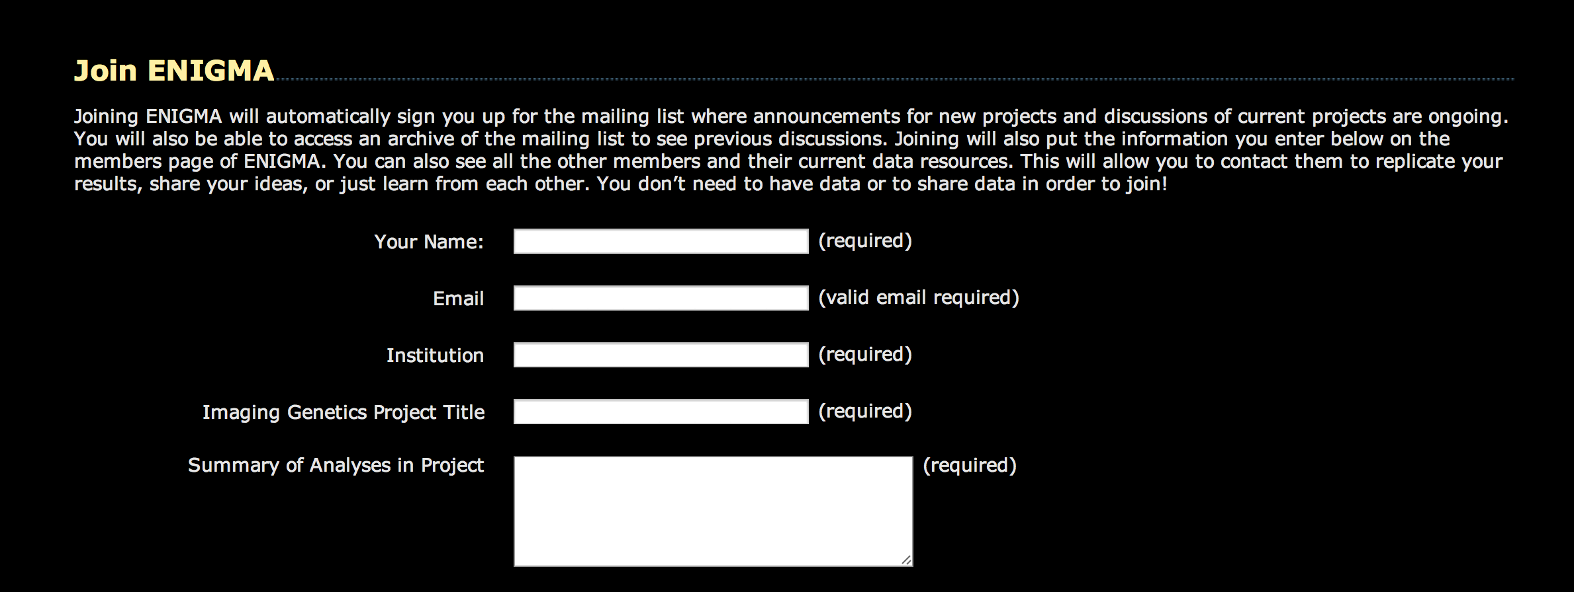
How to Take Part in ENIGMA
http://enigma.ini.usc.edu/members/join/
enigma@ini.usc.edu

Slide 17
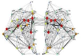



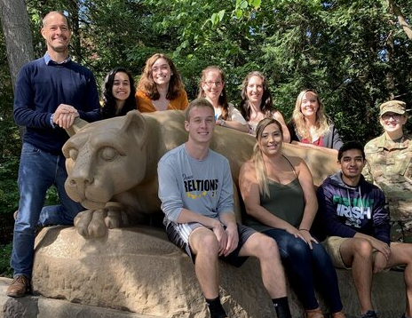
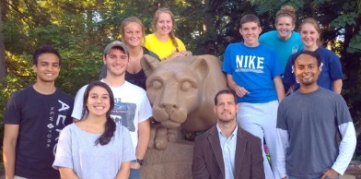











Brain Injury, Plasticity
And Recovery Lab
Sarah M. Rajtmajer, PhD
Department of IST
Michele Diaz, PhD
Director: Social Life and Engineering Imaging Center
Jose Soto, PhD
Department of Psychology
Peter Molenaar, PhD
Human Dev. Fam Studies
Reka Albert, PhD
Department of Physics
John DeLuca, PhD
Helen Genova, PhD
Ekaterina Dobryakova, PhD
Nancy Chiaravalloti, PhD
Einat Brenner
Emily Grossner
Kristine Dell
Jason Staph
Sami Vervoordt
Andrew Cwiek
Rachel Bernier
John Medaglia
Carrie Esopenko, PhD
Arnab Roy, PhD
Nichlas Gilbert
Monica Benson
Alexander Rembalsky
Brenden Johns
Adwait Chafale
Alexander
Olsen, PhD
Paul M. Thompson, PhD
Karen Caeyenberghs, PhD
NINDS: R61 NS120249
NINDS R01 NS115957
NICHD: UL Tr000127
PA Dept of Health
SAP#4100077082
RADIOLOGY
Jianli Wang, MD,PhD
PM&R
Justin Hong, MD
Elisabeth A. Wilde, PhD
David Tate, PhD
Emily Dennis, PhD
Jordan Grafman, PhD
Vince D. Calhoun, PhD
Victor Vergara PhD
09.001.BIR1

Slide 18
Benefits to data sharing, team science and open science:
Benefit 1: Collective structures for guiding science
Benefit 2: Built-in opportunities for replication
Benefit 3: Larger samples, more nuanced hypotheses, and greater confidence in research
Benefit 4: Less devotion to finding p<0.05
Benefit 5: Identify failing pathways faster

Slide 19
Challenges to data sharing, team science and open science:
Challenge 1: Restrictions on investigator flexibility
Challenge 2: The time cost (current)
Challenge 3: Incentive structure for sharing isn’t in place yet (publications, funding).
“trade-off between quality and quantity appears to be tipped in favour of quantity in the current incentive structure”
--Allen & Mehler, 2019

